Slide 1

Overlay Strategy Using HMMs
Application of Hidden Markov Models to Algorithmic Trading
Joel Thomas, Victoria Zhang and Liam Horrocks

Slide 2
Strategy Overview

Slide 3
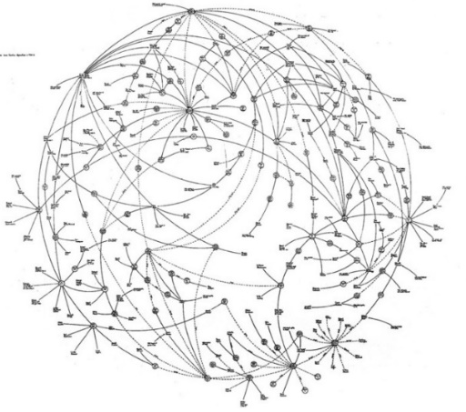
Strategy Overview
Nominal Interest Rate
Inflation Rate
Hidden Markov Model
Macroeconomic Factors
Next Month Macro Situation
Consumer Credit Change
?
Volatility Index

Slide 4
Predicting Macroeconomic Situation using HMMs

Slide 5
Intro to HMM
Unsupervised Machine Learning algorithm
Area of ML that learns from unlabelled, unclassified or uncategorised test data
Probabilistically model an observation sequence of random processes
Extension to Markov Chains
Presence of hidden or latent variables
Cannot be observed in real life

Slide 6

Prediction Using HMMs
Hidden
State 1
State 2
State 3
State 4
Observed
$$λ$$
Parameters
Nominal Interest Rate
Inflation Rate
Volatility Index
Consumer Credit Change
?
Macroeconomic Vector

Slide 7
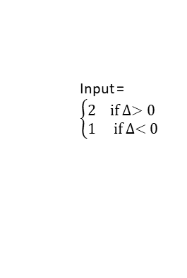
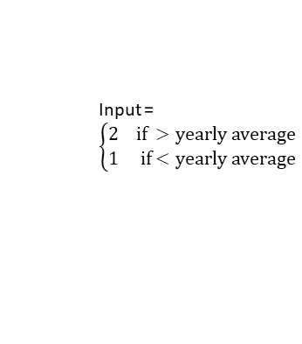
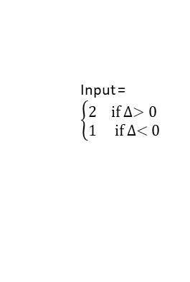
Prediction Using HMMs
Hidden
State 1
State 2
State 3
State 4
$$λ$$
Parameters
Nomial Interest Rate
Inflation Rate
Volatility Index
Consumer Credit Change
?
Input = $\left\{\begin{aligned}&2 if ∆>0 \\ &1 if ∆<0\end{aligned}\right.$
Input = $\left\{\begin{aligned}&2 if ∆>0 \\ &1 if ∆<0\end{aligned}\right.$
Input = $\left\{\begin{aligned}&2 if ∆>0 \\ &1 if ∆<0\end{aligned}\right.$
Input = $\left\{\begin{aligned}&2 if >yearly average \\ &1 if<yearly average\end{aligned}\right.$
Macroeconomic Vector

Slide 8
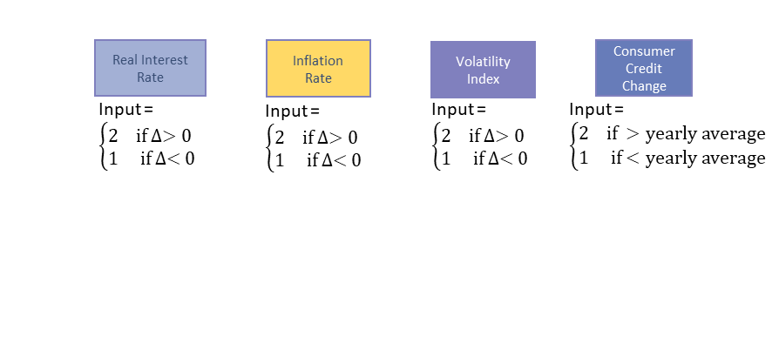
Mechanism of Overlay Strategy
Prediction = 1
 | SPY | Gold | Cash | VIX
Nominal Interest Rate | Long | Long | Short | Short
Inflation | Short | Short | Long | Long
VIX | Long | - | - | -
Consumer Credit Change | Short | Short | Long | Long

Slide 9
Mechanism of Overlay Strategy
e.g. Predicted Vector = (1,2,2,1)
Predicted 1 |  |  |  |  | Predicted 2
 | SPY | Gold | Cash | VIX | SPY | Gold | Cash | VIX
Nominal Interest Rate | Long | Long | Short | Short | Short | Short | Long | Long
Inflation | Short | Short | Long | Long | Long | Long | Short | Short
VIX | Long | - | - | - | Short | - | - | -
Consumer Credit Change | Short | Short | Long | Long | Long | Long | Short | Short

Slide 10
Mechanism of Overlay Strategy
e.g. Predicted Vector = (1,2,2,1)
Predicted 1 |  |  |  |  | Predicted 2
 | SPY | Gold | Cash | VIX | SPY | Gold | Cash | VIX
Nominal Interest Rate | Long | Long | Short | Short | Short | Short | Long | Long
Inflation | Short | Short | Long | Long | Long | Long | Short | Short
VIX | Long | - | - | - | Short | - | - | -
Consumer Credit Change | Short | Short | Long | Long | Long | Long | Short | Short

Slide 11
Mechanism of Overlay Strategy
e.g. Predicted Vector = (1,2,2,1)
Predicted 1 |  |  |  |  | Predicted 2
 | SPY | Gold | Cash | VIX | SPY | Gold | Cash | VIX
Nominal Interest Rate | Long | Long | Short | Short | Short | Short | Long | Long
Inflation | Short | Short | Long | Long | Long | Long | Short | Short
VIX | Long | - | - | - | Short | - | - | -
Consumer Credit Change | Short | Short | Long | Long | Long | Long | Short | Short
SPY |  | Gold |  | Cash |  | VIX
Long | Short | Long | Short | Long | Short | Long | Short
2 | 2 | 2 | 1 | 1 | 2 | 1 | 2

Slide 12
Mechanism of Overlay Strategy
e.g. Predicted Vector = (1,2,2,1)
Predicted 1 |  |  |  |  | Predicted 2
 | SPY | Gold | Cash | VIX | SPY | Gold | Cash | VIX
Nominal Interest Rate | Long | Long | Short | Short | Short | Short | Long | Long
Inflation | Short | Short | Long | Long | Long | Long | Short | Short
VIX | Long | - | - | - | Short | - | - | -
Consumer Credit Change | Short | Short | Long | Long | Long | Long | Short | Short
SPY |  | Gold |  | Cash |  | VIX
Long | Short | Long | Short | Long | Short | Long | Short
2 | 2 | 2 | 1 | 1 | 2 | 1 | 2

Slide 13
Limitations & Discussion

Slide 14
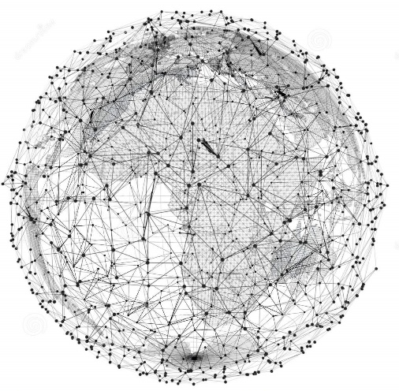
Limitations
Information Capturing:
Database Constraint:
Multiple datasets not available
Computational expense
Limited Number of Hidden States
1
2

